Slide 1
Python for Analysts
CCAA Meeting October 12th 2021
Rachel Stevenson - Colorado Information Analysis Center

Slide 2

Agenda
What This Session Is and Is Not
Key Terms
Why Python?
Benefits of Python
When should you use python?
Python Analysis Example
Python References and Resources

Slide 3
What This Session Is and Is Not
This Session will:
Tell you what Python Can Do
Provide a Basic Understanding of What Python Is
Provide a Demo of Python in Action
Provide Resources and References for How to Learn Python Coding
This Session Will Not:
Teach You how to write python code.

Slide 4
Key Terms
Python - An Object Oriented Programming Language, with high level functionality and easy to understand syntax.
Free Open Source Software (FOSS) - Software that is open to the community and can be built upon and taken and adjusted as is needed. Free == Freedom, Free != Free Monetarily.
Variables and Data Types - Terms used in Python to denote the types of data and identification of data sets within python.
Libraries - Python uses libraries to provide different capabilities. These can include: Conversion of Documents, Creation of Maps, Charts and Other Data Visualization etc.

Slide 5



Why Python?
Good for basic analysis and cleaning of data.
Has limitations on how big the spreadsheet can be
The bigger your data gets, the slower this tool will become.
Has an acceptable cost associated with it.
Analyst Common Tools:
Microsoft Excel
R/R Studio
SPSS IBM
Tableau
Other Programming Languages
Great Product for statistical analysis! Can do some data cleaning.
Zero Cost, Heavy time requirement to Learn.
Great product for statistical analysis, Steep learning curve, expensive cost

Slide 6

Why Python?
You have lots of tools within your toolbox for doing analysis, Python is just a additional tool. A steak knife instead of a butter knife.
What Does Python Do:
Makes data cleaning and data processing a much smoother process.
After the initial script is developed, some minor tweaks can be made to use that script multiple times. (This will be demonstrated later)
Can Automate Tasks, that can be scheduled to run in the background.
Python has lots of libraries that can do lots of different types of analysis and display options.

Slide 7
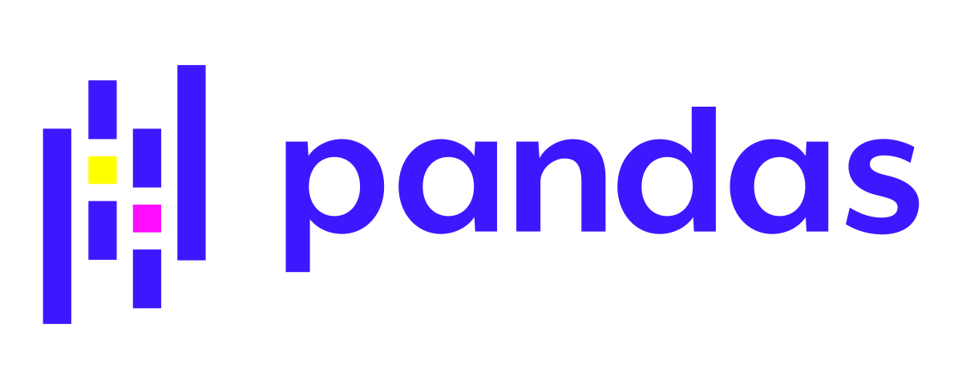

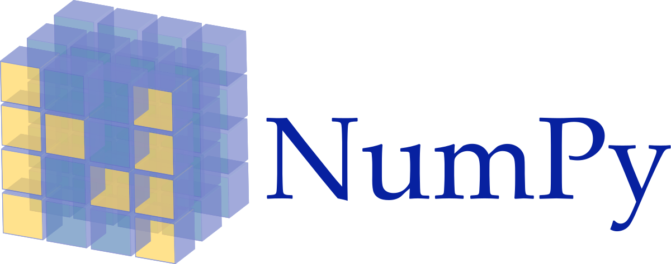
Benefits of Python
Extensive Support Libraries:
Data Science:
Pandas
Geopandas
SciPy
Numpy
BeautifulSoup (Web Scraping)
Machine Learning:
TensorFlow
Py Torch
Keras
Open Source and Community Development
Slight Steep Learning Curve

Slide 8
When Should You Use Python?
Automate Daily, Weekly, Monthly Tasks
Denver Chief of Police Wants Monthly Numbers for all Arrests for all the police stations within each of the 6 districts.. At 6 am 1st of the month. THATS 20 Police Stations/Substations per district. (120) Arrests from each station is about 1,000 Roughly each month… You don't have time to do this by hand..
Daily Task: Email Notification System when data is sent to you from all all the substations you get an notification that you have received the data for that months report.
Weekly Task: Data Cleaning Each Districts data As it comes in. You have a Python Script for this. It cleans the data, develops the Charts, Maps, Lastly this Script outputs each Stations Arrest Report as a PDF with the date, time and your name.
Monthly Task: After all your reports have been made into PDF reports, One Last script Creates a Zipped Folder and emails all reports to the deputy chief of police, who prints them out and puts them on the Chief of Police Desk for their 6am Coffee session.
Bad News: The time it takes you to build all of these scripts, so that you have flawless execution: takes about a month and a half to develop, test and implement.
Good News: Once completed, the process takes about 30 minutes total for these reports to be put together.

Slide 9

Python Analysis Example
Tools and Data:
Tool: Jupyter Notebook - Browser Based Application for writing Python or R code.
Tool: Github Repository - Where Scripts are Stored
Data: Denver Crime Data - Last 5 Years
Libraries:
Pandas
Seaborn

Slide 10


Python Learning References
Online Courses (Free): Free Code Camp
Online Courses (Payment): Coursera
Youtube Channels(Free):
FreeCodeCamp
Beautiful Soup
Tech With Tim
In Person Classes (Payment)

